Slide 1
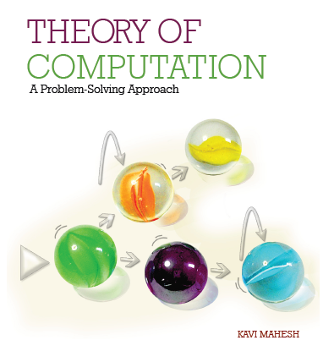
Theory of Computation: A Problem-Solving Approach
Chapter – 12: Computability and Undecidability

Slide 2
Learning Objectives
Learn to solve simple cases of the Post Correspondence Problem (PCP).
Learn why PCP is unsolvable.
Learn the difference between decidability and computability.
Learn why some problems are not computable.
Understand why Turing Machines suffer from the halting problem.
Appreciate kinds of problems that are undecidable.
Get an overview of the field of computational complexity.
Understand the difference between recognition and recall in computing solutions.
Wonder about several open questions in the science of computing.

Slide 3
Post Correspondence Problem
A string matching problem
Given two sets (sequences, in fact) of strings W and V (over the same alphabet) each having n strings:
W = {w₁, w₂, w₃, …, w_{n}} and V = {v₁, v₂, v₃, …, v_{n}}
The problem is to find some concatenation of one or more strings from the set W, in any order, where the resulting concatenated string is identical to the corresponding concatenation, in the same order, of strings from the set V.
The simpler version of the PCP is to find some permutation of the indexes of elements of the sets 1, 2, 3, 4, …, say, i₁, i₂, i₃, i₄, … so that when concatenated in that order, we get identical concatenations, that is,
w_{i1}.w_{i2}.w_{i3}… = v_{i1}.v_{i2}.v_{i3}…
The V strings must be concatenated in the same order as the W strings.
Can we find such a permutation given any two sets of strings W and V each containing n strings?

Slide 4
Post Correspondence Problem
The general case of the PCP is more complex.
What if we allow repetitions of strings? That is, each w_{i} or v_{i} can be used any number of times in the concatenations.
As such, there is no limit on the length of the concatenations, although we only consider finite numbers of concatenations as solutions to the PCP.
There are instances of the PCP that have no solution if repetitions are not allowed but do present solutions when repetitions are included (see Example 12.2).
What is a good algorithm to solve the Post Correspondence Problem?
There is no algorithm!
PCP is not computable! It is an undecidable problem!

Slide 5
PCP: Example 12.1
Consider
W = {bb, baa, bbb}
V = {bbb, aab, bb}
Let us try: i₁ = 1, i₂ = 2 and i₃ = 3, and
w_{i1}.w_{i2}.w_{i3} = bb.baa.bbb =
v_{i1}.v_{i2}.v_{i3} = bbb.aab.bb = bbbaabbb

Slide 6
PCP: Example 12.2
Consider another PCP instance:
W = {a, ab, bba}
V = {baa, aa, bb}
What is a good algorithm for solving this problem?
Can we apply an exhaustive search by considering all possible permutations?
Solution:
w₃.w₂.w₃.w₁ = bba.ab.bba.a
v₃.v₂.v₃.v₁ = bb.aa.bb.baa
Note that there are further solutions:
w₃.w₂.w₃.w₁.w₃.w₂.w₃.w₁ = bbaabbbaabbaabbbaa
= v₃.v₂.v₃.v₁.v₃.v₂.v₃.v₁

Slide 7
PCP: Example 12.3
Let us look at one final example:
W = {a, aa, b}
V = {aa, ab, bb}
Try:
w₁.w₂.w₃.w₃ = a.aa.b.b
v₁.v₂.v₃.v₃ = aa.ab.bb.bb
Or
w₃.w₃.w₃ = b.b.b…
v₃.v₃.v₃ = bb.bb.bb…
There is no solution! We end up in an infinite loop..

Slide 8
Why is PCP Unsolvable?
PCP is equivalent to derivation in a unrestricted grammar
If PCP is solvable, then membership of a string in the language of an unrestricted grammar becomes computable
These grammars are equivalent to Turing machines
Every Turing machine acceptor becomes a decider machine
This means that every recursively enumerable language has a membership function
That is, every recursively enumerable language is recursive
This contradicts what we found (in Chapter 11) using diagonalization
Not all recursively enumerable languages are recursive
Therefore membership in unrestricted grammars is not computable

Slide 9
Modified PCP
For convenience,
Assume that concatenation always starts with the first strings in each sequence
That is, there is a simple additional constraint that i₁ = 1 always
Consider a derivation of the string aabababb which belongs to the language over {a, b} of strings with equal numbers of a and b (i.e., n_{a} = n_{b}):
S → aSB | bSA | SS | λ
A → a
B → b
Make it unrestricted if needed:
S → aSBB | bSAA | SS | λ
AA → a
BB → b

Slide 10
Derivation Example
Derivation of aabababb

Slide 11
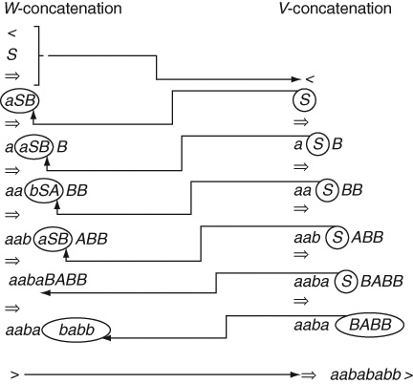
Equivalence of PCP and Derivation

Slide 12
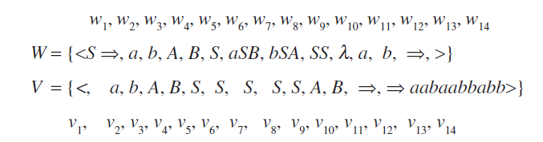
Equivalent MPCP Instance

Slide 13
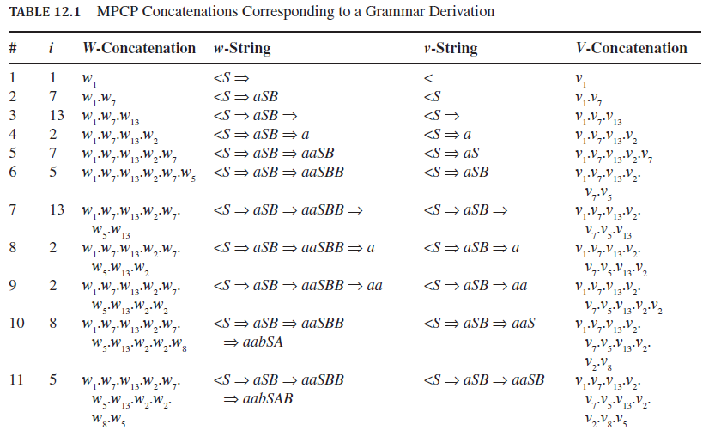
MPCP Concatenations

Slide 14
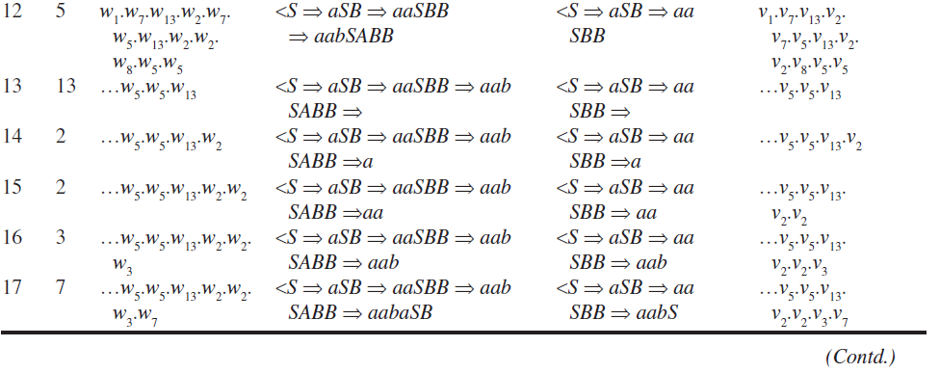
MPCP Concatenations (contd..)

Slide 15
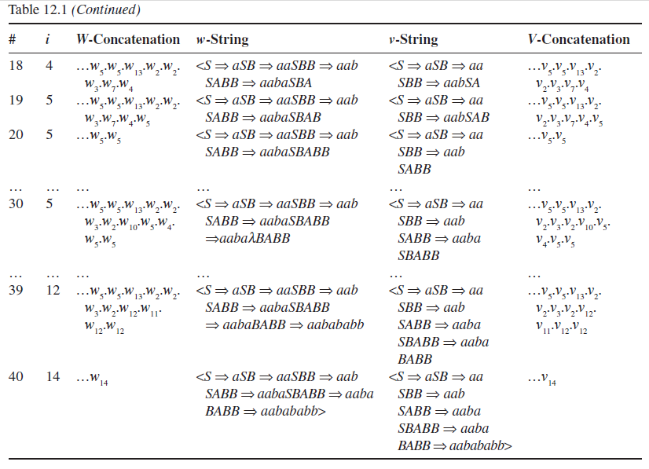
MPCP Concatenations (contd..)

Slide 16
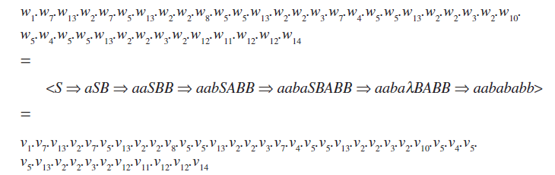
MPCP Solution and Derivation

Slide 17
Halting Problem of Turing Machines
Consider a Turing machine acceptor that is not a decider (i.e., it is for a recursively enumerable language that is not recursive)
What happens if it is given an input string that is not a member of the language?
It may halt and reject the string
Or
It may never halt, i.e., it may go into an infinite loop

Slide 18
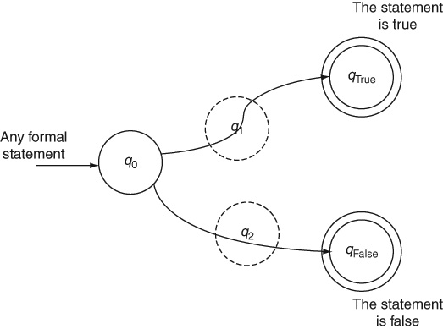
Universal Oracle Machine

Slide 19
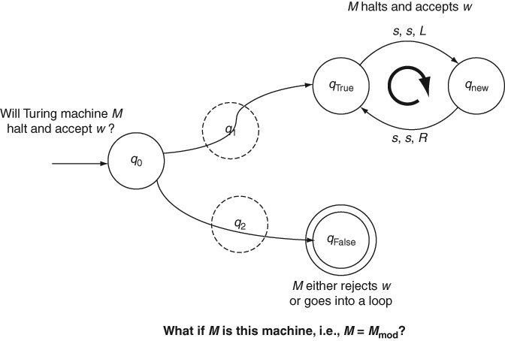
Modified Oracle Machine

Slide 20
Universal Oracle Cannot be Built
We play the trick of “a snake eating its own tail,” that is, we give the binary encoding of M_{mod} itself (along with some input string w) as the input to M_{mod}.
In other words, the input data to this “program” is the “program” itself. We are thereby asking the question: will M_{mod} halt on the input w and we are asking this question to M_{mod} itself!
Given the definition of M_{oracle} and the modification we did to arrive at the design of M_{mod}, we are now forced to conclude that:
M_{mod} will halt in its state q_{False} whenever M_{mod} rejects its input or fails to halt.
M_{mod} fails to halt and goes into an infinite loop through its state q_{True} whenever M_{mod} halts and accepts its input.
In other words, M_{mod} halts whenever it does not halt and it does not halt whenever it halts.
This is obviously impossible and ridiculous. It is a contradiction. Therefore, our assumption that we can construct a universal oracle M_{oracle} must have been wrong. There is no such decider machine and Turing Machines do suffer from the halting problem.

Slide 21
Problem Reduction
This technique of proof is called problem reduction.
A problem P₁ is shown to be unsolvable by reducing another problem P₂ to P₁ where P₂ is known to be unsolvable.
If P₁ were to be solvable, then P₂ would also become solvable via the reduction, thus showing us that P₁ is indeed unsolvable.
Similar arguments are used in complexity analysis to show that a given problem is NP-Complete

Slide 22
The Ideas of Computability and Decidability
A mathematical function f: D R from a domain set D to a range set R is computable if there exists a Turing Machine M that, given any input string w from the domain D, goes from its start state to a final state and halts there with f(w) written as the output on the tape.
If the function f is a Boolean function, then the output f(w) written on the tape is not significant; what matters is whether the machine halts in an accepting final state q_{True} or halts in a rejecting final or non-final state q_{False}.
Such Boolean functions are called decidable functions.
As noted in Chapter 1, we can convert any function to a Boolean function by including the answer in the input.
If a type of problem or, equivalently, a formal language has a decider Turing Machine, then it is said to be computable or decidable.
In other words, all recursive languages are computable or decidable.

Slide 23
Undecidability: Summary
PCP is an unsolvable problem, that is, it is not computable because if it was, then all recursively enumerable languages would become recursive. This is a contradiction since we already know of the existence of languages such as L_{Diag} and L_{Non-RE} (see Chapter 11) found by the method of diagonalization.
Turing Machines suffer from the halting problem for the same reason. If there was no halting problem, we could convert every acceptor machine to a decider, thereby making every recursively enumerable language recursive.
The halting problem of Turing Machines shows why certain functions are not computable (and also explains the reason for Gödel’s Incompleteness Theorem).
This limitation of the very idea of computation is applicable to many practical problems such as the PCP in string matching.

Slide 24
Undecidable Problems
Halting problem of Turing machines: given an arbitrary Turing machine and an arbitrary input string, does the machine halt on that input?
Various problems in predicting the behaviors of Turing Machines such as the state entry problem in a Turing Machine: Given a Turing Machine M and input w, will M enter a particular state q_{i} in processing w?
Blank-Tape Halting Problem: Given a blank tape as input, will a Turing Machine M halt?
Given an unrestricted grammar G, is G.language empty?
Given a Turing Machine M, is M.language infinite?
Given a Turing Machine M, is M.language regular or context-free?

Slide 25
Undecidable Problems (contd..)
Equivalence of context-free grammars: Suppose two designers have independently developed two different grammars for a language (e.g., a new programming language). Do the two grammars represent the same language? That is, given G₁ and G₂ as two context-free grammars, the problem of answering is G₁.language = G₂.language is undecidable.
The problem of determining, given two context-free grammars G₁ and G₂, whether the intersection of G₁.language and G₂.language is null, is undecidable, that is, we can’t even determine whether there is a common string between the two languages.
Given a context-free grammar G, is G ambiguous is undecidable?
Given a context-free grammar G, is G.language = Σ* is undecidable?
Equivalence of push-down automata is also undecidable. Just like their context-free grammar counterparts, we cannot write an algorithm that determines if the languages of two push-down automata are the same.

Slide 26
Undecidable Problems (contd..)
We were able to minimize a deterministic finite automata (see Chapter 3). There is no minimization algorithm for a push-down automaton. Finding an equivalent push-down automaton with a minimum number of states is undecidable.
Even the membership problem in an unrestricted grammar is undecidable. Given a grammar G and a string w, it is undecidable whether w is a member of G.language!
On the same lines, the language of all strings accepted by corresponding Turing Machines is undecidable. That is, we cannot determine whether a given string is accepted by a given Turing Machine.
The problem of inference or semantic entailment in first-order predicate logic is undecidable.

Slide 27
Undecidable Problems: Rice’s Theorem
A generalization of the above problems, called Rice’s Theorem, says that any non-trivial property of a recursively enumerable language is undecidable!
A trivial property is one that is either true for all elements of a set or false for all elements of the set.
For example, the property that all recursively enumerable languages have an acceptor Turing Machine is trivial.
A non-trivial property here is one which is true for some recursively enumerable languages and false for other recursively enumerable languages.
For example, the property that only some of them are recursive or that only some of them are context-free is non-trivial.

Slide 28
Other Computing Models
All other computing models are equivalent to Turing machines
E.g., Lambda calculus, Post Machines and Markov Algorithms are equivalent to recursively enumerable languages and Turing Machines
Recursive functions: primitive recursive functions
E.g., add(m, 0) = m;
add(m, n+1) = successor(add(m, n));
E.g., multiply(m, 0) = 0;
multiply(m, n+1) = add(m, multiply(m, n));
Include minimum function to get μ-recursive functions which are also equivalent to Turing computable functions

Slide 29
Ackermann Function is Computable
An example of a function that is computable, that is, μ-recursive but not primitive recursive, is the Ackermann function:
A(m, n) = n + 1 if m = 0,
A(m – 1, 1) if m > 0, n = 0
A(m – 1, A(m, n – 1)) if m > 0, n > 0.
Ackermann function grows very rapidly. For example,
A(2, 2) = 7
A(3, 2) = 29
and
A(4, 2) = 2⁶⁵⁵³⁶ – 3

Slide 30
Computational Complexity and Efficiency
How efficient can computable functions be?
What is the minimum amount of resources (time, space) needed to compute something?
Time complexity: measured in number of steps or primitive operations needed
Space complexity: measured in number of memory cells needed
Both are stated in relation to the problem size n
How fast does the complexity function increase as the problem size n increases?
E.g., n² grows faster than n log n

Slide 31
Best, Average and Worst Case Complexity
Best case complexity: What is the minimum number of steps required to compute a solution for the best possible input for the algorithm and problem?
Worst case complexity: What is the minimum number of steps required to compute a solution for the worst possible input for the algorithm and problem? This is usually dependant on the algorithm since one algorithm can be more efficient than another for the same problem. However, problems themselves can be shown to have a lower bound on their complexity in the sense that no algorithm for that problem can be more efficient, in the worst case, than the lower bound.
Average case complexity: What is the minimum number of steps required to compute a solution on an average for all possible inputs for the algorithm and problem?

Slide 32
Complexity Classes
The complexity class DTIME(f(n)) is the set of all problems that can be solved in a deterministic Turing Machine within f(n) number of steps.
For example, sorting is a DTIME(n log n) problem
EXPTIME is the class of problems that take time exponential in n to solve (e.g., 2^{n}).
Problems in EXPTIME are considered intractable since exponential functions grow too fast as n increases.
Another class of problems known as NP problems or non-deterministic polynomial problems are those that take exponential time but would take only polynomial time if non-deterministic parallelism is available.
Examples of NP problems:
Boolean Satisfiability problem in logic
Hamiltonian Path problem and the vertex cover problem in graph theory
Integer programming problem in operations research
Protein structure prediction problem in biochemistry

Slide 33
NP-Complete and NP-Hard Problems
Complexity theory further classifies NP problems using the idea of problem reduction into the classes of
NP-Complete problems are those NP problems for which, given a solution, their validity can be verified in polynomial time.
NP-Complete problems are the hardest problems in the class NP
They are also NP-Hard problems such that any NP problem can be reduced to the problem in polynomial time.
They are usually decision problems.
NP-Hard problems are at least as hard as the hardest known NP problem.
A problem is NP-Hard if and only if there exists an NP-Complete problem that is polynomial-time reducible to it.
However, NP-Hard problems need not even be in the class NP. For example, the halting problem is NP-Hard but not NP-Complete.
NP-Hard problems are usually optimization problems such as the well-known traveling salesman problem.
It has been shown that there exist NP-Hard problems that are neither NP-Complete nor undecidable.

Slide 34
Other Complexity Classes
PSPACE which is defined as the set of problems that take an amount of space (i.e., memory) that is polynomial in the size of the input.
It turns out that the class PSPACE is larger than NP but smaller than EXPTIME.
Moreover, it has been shown that the classes PSPACE and NPSPACE, that is, the set of problems that require a polynomial amount of space in a non-deterministic Turing Machine, are the same.
There are NP problems that are neither P nor NP-Complete. An example of such a problem is the graph isomorphism problem in graph theory.
Big question: P = NP?

Slide 35
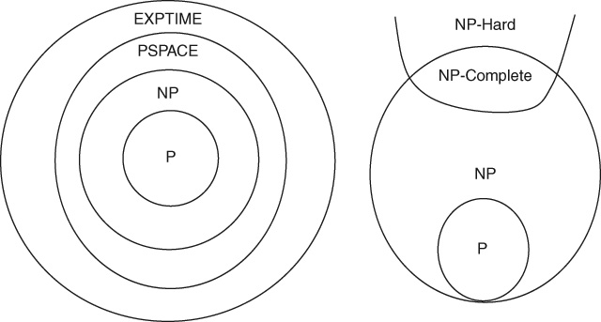
Complexity Classes

Slide 36
Some Open Questions in Computing
Why are DFA and NFA equivalent but not NPDA and DPDA?
Why does it take non-determinism to deal with context-free grammars?
If we allow the input to be processed in two left-to-right passes instead of one, will non-determinism go away?
In non-determinism, who throws the dice to get it right every time? Is it magic?
Can we ever build a non-deterministic machine? Can unlimited parallelism implement non-determinism? Using multi-core processors, multithreading?
Is there a different, new model of the very idea of computing that changes all the equivalences and distinctions? Is it more powerful than the Turing Machine?
Do these statements hold good in radically different computing architectures ?
Can the human mind handle non-determinism? Without a serialized backtracking implementation?
Is P = NP?

Slide 37
Recognition and Recall
The language L_{Diag} from Chapter 11 which is recursively enumerable (but its complement L_{Non-RE} is not,) is a very peculiar language:
It has an enumeration procedure
However, it has no membership function
The Turing Machine can recall and list any member of this language (or set), but it is unable to recognize any of them.
Normal human cognitive behavior suggests the opposite: Recognition is easier than recall.
Computation, as we have modeled it using Turing Machines, however, seems to find it easy to enumerate (recall) than verify (recognize).
Perhaps, we have been doing it all wrong: this is not the right model of computation if our objective is to figure out what is going on in the human mind!

Slide 38
Questions.. Once Again (from Chapter 1)
Why computers have all our pictures in high definition but cannot recognize any of us?
Why computers can be our accountant but not our secretary?
Why computers can calculate so accurately but still have errors (as in “computer errors”)?
Why computers have entire dictionaries but don’t understand a word?
Why computers need programming?
Why computers can run medical systems but can’t cure themselves of viruses?
Why a Web search engine does not distinguish mouse (the animal) from mouse (the computer gadget)?

Slide 39
Theorems
Theorem 33: Undecidability of the Halting problem: The halting problem of Turing machines is undecidable.
Theorem 34: Equivalence of MPCP and derivation: A solution to the Modified Post Correspondence Problem is equivalent to a derivation in an unrestricted grammar.
Theorem 35: Undecidability of PCP: The Post Correspondence Problem is undecidable.
Theorem 36: Rice’s Theorem on undecidable problems: Any nontrivial property of recursively enumerable languages is undecidable.

Slide 40
Key Ideas
A practical problem in string matching known as the Post Correspondence Problem (PCP) has no algorithmic solution. It is an undecidable problem.
It can be shown that solving the Post Correspondence Problem corresponds to deriving a string in an unrestricted grammar.
If PCP is solvable, then we have a membership function for all unrestricted grammars. This would make every recursively enumerable language recursive. This is not the case as we know from the diagonalization argument (in Chapter 11).
There is no algorithmic solution to PCP because of the halting problem of Turing Machines.
Turing Machines suffer from the halting problem when presented with certain inputs that do not belong to the language of the machine. This situation arises when the problem is undecidable, that is, when the language is recursively enumerable but not recursive.

Slide 41
Key Ideas (contd..)
It is not possible to build a universal oracle machine that would answer any question and determine the truth of any given statement. This is why all formal mathematical systems suffer from Gödel’s incompleteness.
If there is no halting problem for Turing Machines, we can build a decider machine for every recursively enumerable language, thereby making the language recursive. Again, this is not possible.
Apart from PCP, there are a number of undecidable (or incomputable) problems including some practical problems in context-free grammars. They show the limitation of algorithmic computation.
Other models of computation such as Post Machines and recursive functions are equivalent to Turing Machines.

Slide 42
Key Ideas (contd..)
Computable problems are classified into a number of complexity classes on the basis of the inherent difficulty of solving various problems. A problem is shown to belong to a class by reducing a known problem in the class to the given problem.
At this time it is unknown whether the class of problems that can be solved in polynomial time is equivalent to the class of nondeterministic-polynomial problems, that is, whether P = NP?
Modern computers based on Turing’s model of a stored-program computing machine are very good at storing and recalling large amounts of data but they are unable to recognize faces, voices, handwritings or other patterns. The human mind, on the other hand, is very good at recognition and rather poor in memorizing and recalling large amounts of data. This difference between abilities for recognition and recall appears to indicate that the human mind does not work according Turing’s model of computing.

Slide 43
End of Chapter 12

